Slide 1
Adaption, Analysis and Evaluation of State-of-the-Art Wav2Vec2 Models on Air Traffic Control Communication Data
Karan Chand s1033357

Slide 2
Content
Introduction
Related work
Methods
Experiments
Results
Discussion
Conclusion

Slide 3
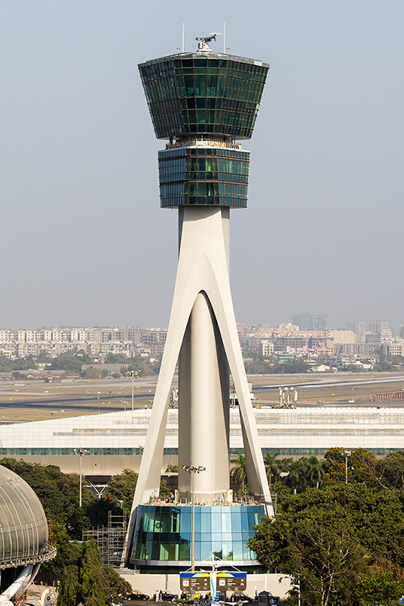
Introduction
Controlling safe and efficient traffic in aviation
Callsigns and commands
Automatic Speech Recognition (ASR)
Decrease workload by a factor of 3 (Helmke et al., 2016)
Source: https://en.wikipedia.org/wiki/Air_traffic_control

Slide 4

“without the dataset, the article is useless”
“speedbird one five six contact rhein one two seven three seven”
Differences of ATC speech compared to regular speech:
ATC data is more noisy
ATC communication does not follow regular speech conventions – callsigns
Standard ASR models perform poorly
Transcribed ATC data is scarce – non-transcribed is not

Slide 5
Motivation
Different model architectures exist:
ANN, HMM and RNN - (Trentin & Gori, 2001)
Wav2Vec2 transformer model:
Lower Word Error Rate (WER)
Insufficiently studied in the ATC domain
State-of-the-art (SOTA) models are still not able to achieve 0% WERs, which is essential in ATC communication

Slide 6
Research questions
How robust are pretrained and fine-tuned ASR models on ATC data?
How does a language model affect the performance of a fine-tuned XLS-R model on ATC data?
How does the amount of data used to fine-tune affect performance of a fine-tuned XLS-R model on ATC data?

Slide 7
Related Work
Fine-tuning on low resource datasets – (Yi et al., 2020) Performance is universal over languages (flexible).
Domain-specific Wav2Vec2 Feasibility of real-time ASR for ATC (Zuluaga-Gomez et al., 2022) WER Reduction (WERR)
Accents in XLS-R - (Babu et al., 2021)

Slide 8
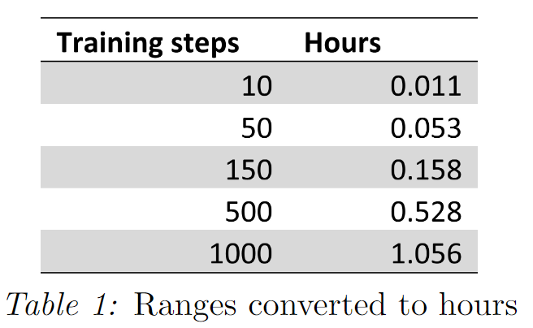
Methods
HuggingFace
SOTA models
Accessibility
Development
Google Colab
Limited resources
Local
Evaluation
WER and Character Error Rate (CER) – not Glue or Bleu
Evaluation → fine-tuning → evaluation → LM → evaluation
Language model
5-gram ARPA file
Only 743 unigrams
Variable LMs out of scope
Fine-tuning
No hyperparameter tuning
Low-medium-high ranges of training data

Slide 9
Models
Pulled from HuggingFace
All Pretrained, some fine-tuned
Base Wav2Vec2 model - Clean
Robust Wav2Vec2 model - Noisy + Clean
XLS-R model - Multilingual + Multi-accent
huBERT model - Improves or matches Wav2Vec2 performance
Choice for research on only XLS-R model:
Accents in ATC
Regularly updated model
Low resources

Slide 10
Experiments
Data
10 hours of speech – average of 3.8s per utterance
Simulated real-time ATC
For public use
Mean perplexity datasets:
Google/fleurs: 35.98
ATCOSIM: 175.08

Slide 11
Data augmentation
Undesirable rows were removed/augmented on conditions:
Rows containing transcriptions that exceed the maximal duration allowed for training and transcription
Transcription containing tags: [HNOISE], [FRAGMENT], [EMPTY], (<OT>. . .</OT>), [NONSENSE] and (<FL>. . .</FL>).
Characters found in transcriptions, separated by “\”: [\=\ ̃\@\,\?\.\!\-\;\:\”\“\%\‘\”\’]
Original ATCOSIM: 10078 rows After cleaning: 9397 rows
Train-validation-test split of 8:1:1 →7526:940:931 rows → 1000:50:931 rows

Slide 12
Settings
No tuning of hyperparameters
Fine-tune for 7500 steps
100 step warm-up phase
Locally on Geforce GTX 1080
Effective batch size of 8
Linear learning rate of 3e-4

Slide 13
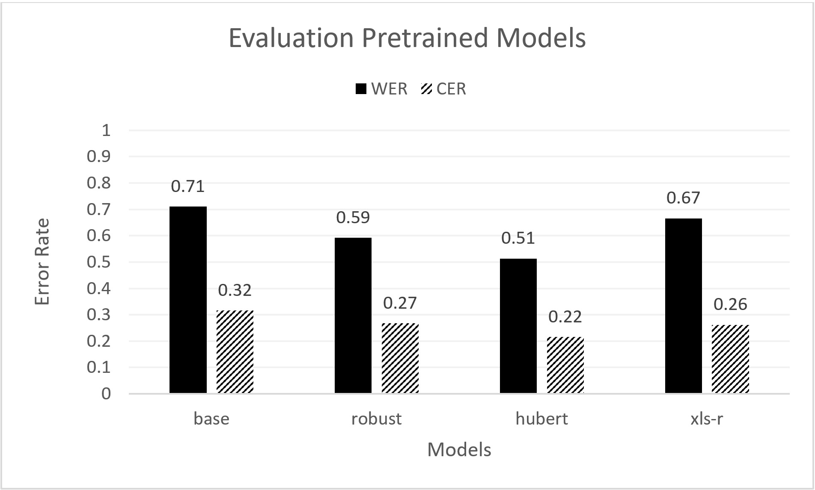
Results
Figure 1: Evaluation of pretrained models in WER and CER.

Slide 14
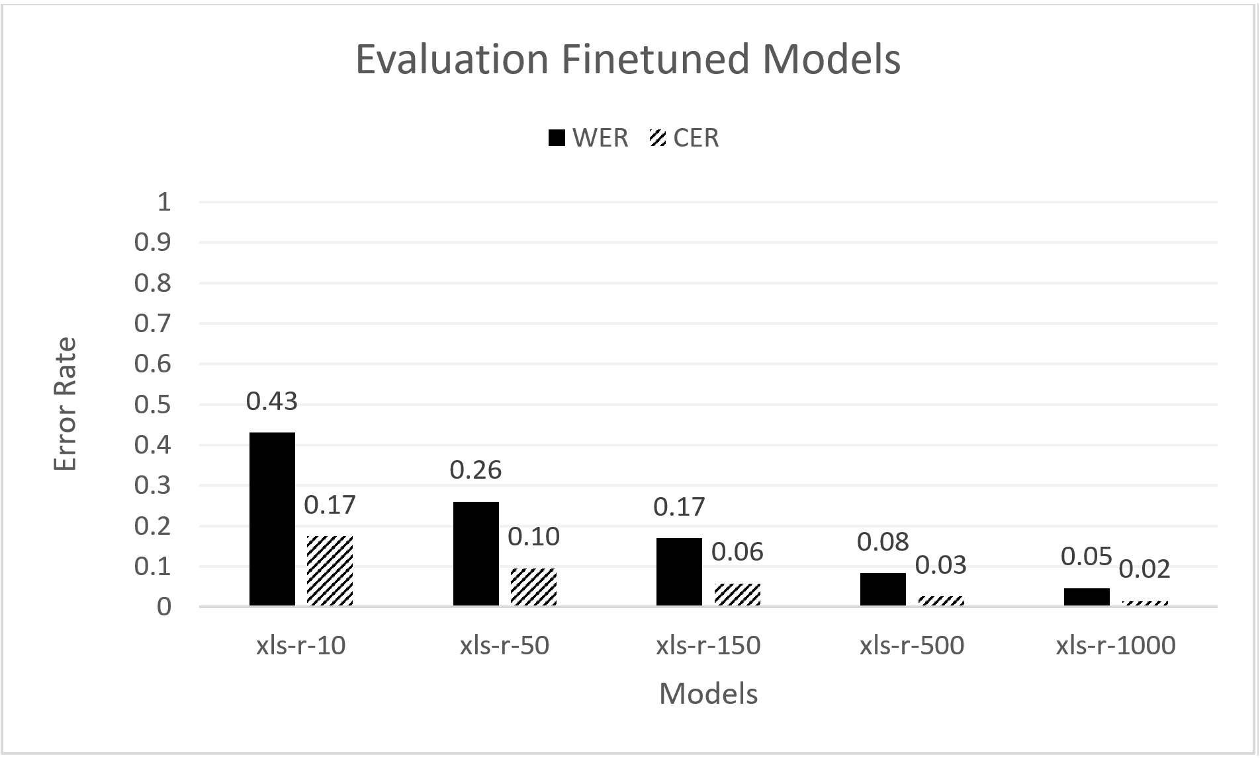
WERR of ~93% and CERR of ~92% for XLS-R-1000
Figure 2: Evaluation of the fine-tuned XLS-R models in WER and CER.

Slide 15
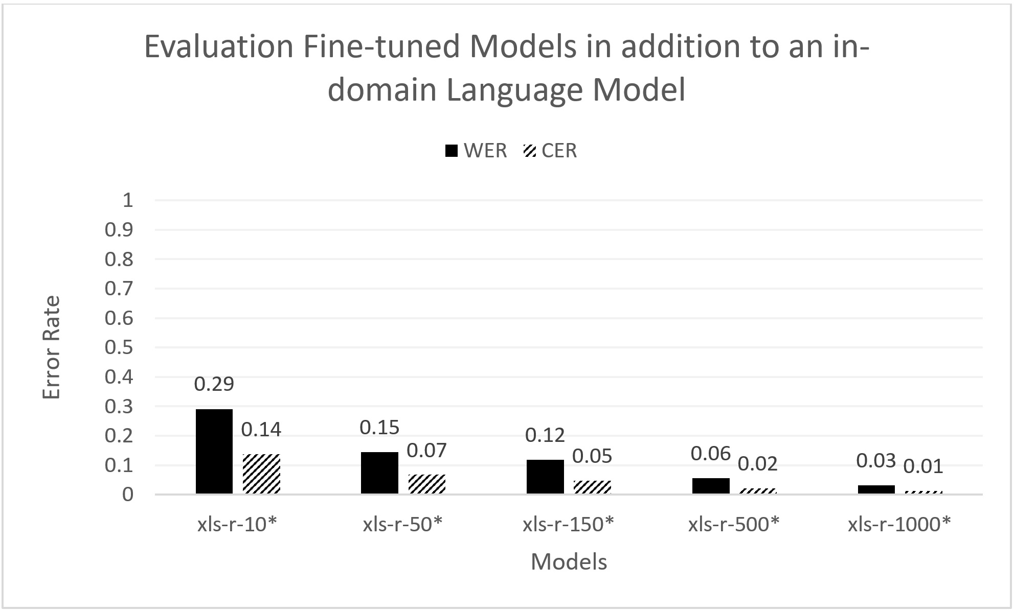
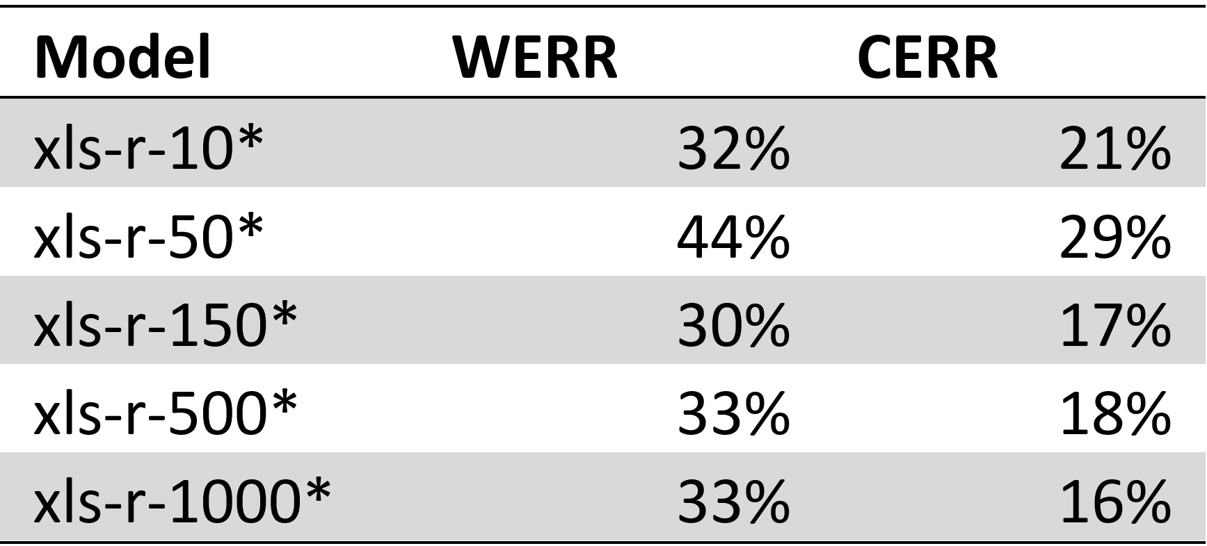
Relative ~33% WERR and ~20% CERR
Table 2: The columns ’WERR’ and ’CERR’ represent the increase in performances found in figure 3 (in-domain LM), relative to figure 2 (no in-domain LM).
Figure 3: Evaluation of the fine-tuned XLS-R models in addition to a LM in WER and CER.

Slide 16
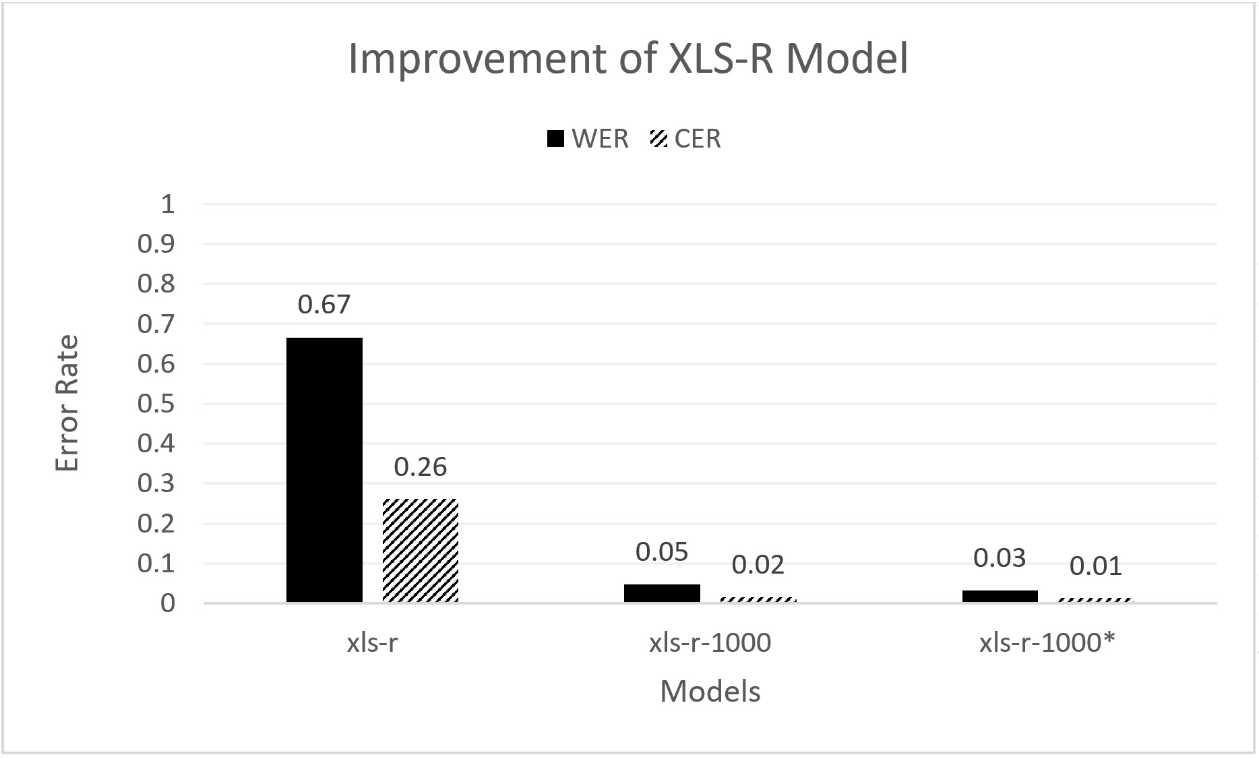
Figure 4: Improvement of the XLS-R model in WER and CER.

Slide 17
Discussion
Comparison to Zuluaga-Gomez et al. 2022
Achieved WERs of 40% and 43% on 5 minutes of ISAVIA and NATS data
XLS-R-10* achieved WER of 29% using ~40 seconds of ATCOSIM data
Comparison should not be made

Slide 18
Discussion
Unusually high performance – Overfitting
WERR and CERR of ∼95.5% and ∼96.1%
Similar data – 10 speakers
Language model constructed from 90% of data

Slide 19
Evaluation XLS-R-1000*
Callsign Detection
Recognizable, but incorrect
transcription | recording_id | model_transcription | difference
golf bravo victor juliett india is identified good afternoon | 051_0227 | goll bravo victor juliett india is identified good afternoon | {'golf'}
hallo lufthansa five two nine four radar contact climb flight level three three zero | 111_0387 | hallo lufthansa five to nine four radar contact climb flight level three three zero | {'two'}

Slide 20
Evaluation XLS-R-1000*
Single word prediction
Without context, model relies on the LM
Implications in practice?
transcription | recording_id | model_transcription | difference
exact | 111_0627 | expect | {'exact'}

Slide 21
Evaluation XLS-R-1000*
Uh, Oh
Small ambiguous ‘errors’
Should this impact performance?
transcription | recording_id | model_transcription | difference
roger what is your position | 101_0199 | roger ah what is your position | set()

Slide 22
Evaluation Metric
What is captured by WER and CER?
Concept Error Rate (ConER)
Use labelled transcribed data for classification (Command or callsign)
Ratio of correctly transcribed concept
Command Error Rate (CmdER)
Rate of correctly transcribed concepts in a sentence
(Oualil et al., 2015)

Slide 23
How robust are pretrained and fine-tuned ASR models on ATC data?
Models imported from HuggingFace are not robust; WER and CER of 51% and 22% respectively (huBERT)
Fine-tuned XLS-R-1000 model achieved a reasonable (Helmke et al., 2016) WER of ~5%
Addition of an in-domain LM provides a high performance XLS-R-1000* model
Minor training and an LM can have a major impact on performance

Slide 24
How does a language model affect the performance of a fine-tuned XLS-R model on ATC data?
~33% decrease of WER
~20% decrease of CER
Cheap performance boost
Table 2: The columns ’WERR’ and ’CERR’ represent the increase in performances found in figure 3 (in-domain LM), relative to figure 2 (no in-domain LM).

Slide 25
How does the amount of data used to fine-tune affect performance of a fine-tuned XLS-R model on ATC data?
More training data = higher performance
Maximum of 10% of available training data is used
Figure 2: Evaluation of the fine-tuned XLS-R models in WER and CER.

Slide 26
Further Research
Additional models
Only XLS-R model is fine-tuned
Addition of LM to raw HuggingFace Models
Variable training data
~1 hour of training data
Tuning hyperparameters
Generalization
Evaluate on different datasets
Additional language models
N-grams
Finite state machine for utterance generation (Yitsz Neurink)

Slide 27
Conclusion

Slide 28
References
Helmke, H., Ohneiser, O., Muhlhausen, T., & Wies, M. (2016). Reducing controller workload with automatic speech recognition. AIAA/IEEE Digital Avionics Systems Conference - Proceedings, 2016-December. https://doi.org/10.1109/DASC.2016.7778024
Hofbauer, K., Petrik, S., & Hering, H. (n.d.). The ATCOSIM Corpus of Non-Prompted Clean Air Traffic Control Speech
Trentin, E., & Gori, M. (2001). A survey of hybrid ANN/HMM models for automatic speech recognition. In Neurocomputing (Vol. 37).
Yi, C., Wang, J., Cheng, N., Zhou, S., & Xu, B. (2020). Applying Wav2vec2.0 to Speech Recognition in Various Low-resource Languages. http://arxiv.org/abs/2012.12121
Zuluaga-Gomez, J., Prasad, A., Nigmatulina, I., Sarfjoo, S., Motlicek, P., Kleinert, M., Helmke, H., Ohneiser, O., & Zhan, Q. (2022). How Does Pre-trained Wav2Vec2.0 Perform on Domain Shifted ASR? An Extensive Benchmark on Air Traffic Control Communications. http://arxiv.org/abs/2203.16822
Babu, A., Wang, C., Tjandra, A., Lakhotia, K., Xu, Q., Goyal, N., Singh, K., von Platen, P., Saraf, Y., Pino, J., Baevski, A., Conneau, A., & Auli, M. (2021). XLS-R: Self-supervised Cross-lingual Speech Representation Learning at Scale. http://arxiv.org/abs/2111.09296
Oualil, Y., Schulder, M., Helmke, H., Schmidt, A., & Klakow, D. (2015). Real-Time Integration of Dynamic Context Information for Improving Automatic Speech Recognition. In Sixteenth Annual Conference of the International Speech Communication Association. https://www.isca-speech.org/archive v0/interspeech 2015/papers/i15 2107.pdf

